Slide 1
Year 1 Phonics Meeting- Term 2
Part 2

Slide 2
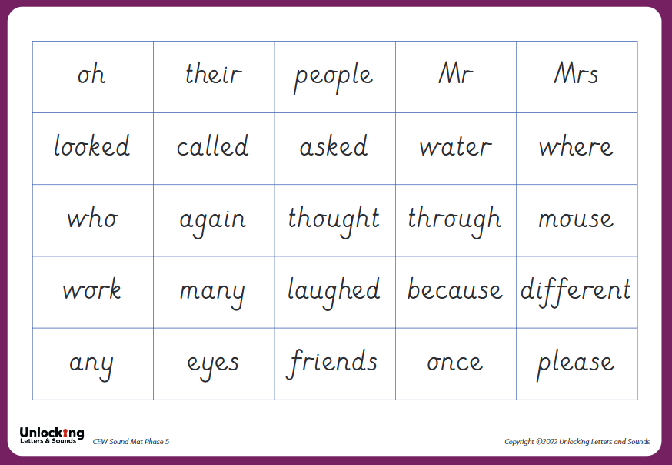

Phase 5 CEWs

Slide 3
https://www.youtube.com/watch?v=lOG_d5Zf3Ws
Please use this link to view correct pronunciation of phonemes

Slide 4
https://www.youtube.com/watch?v=lOG_d5Zf3Ws
Please use this link to view correct pronunciation of phonemes

Slide 5
https://www.youtube.com/watch?v=lOG_d5Zf3Ws
Please use this link to view correct pronunciation of phonemes

Slide 6
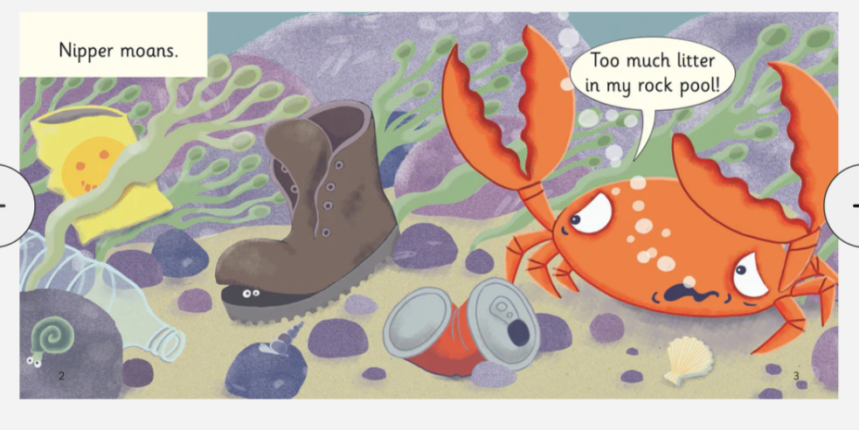
How to support reading - Phase 3 Book

Slide 7
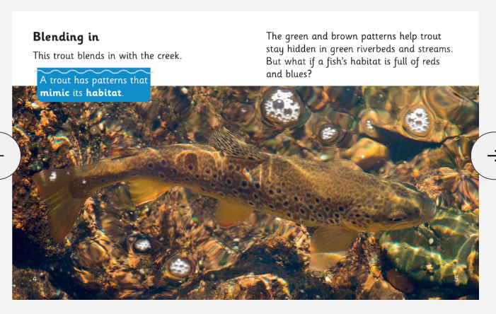
How to support reading - Phase 5 book

Slide 8
Phonics Screening Check
Every Year 1 child in the country will be taking the phonics screening check in June.
The aim of the check is to ensure that all children are able to read by the end of year two.
The test contains 40 words - a combination of 20 real words and 20 pseudo words (nonsense/alien words).
Pseudo words are used to assess a child's ability to decode and blend sounds, as they must sound out the word instead of relying on memory or recognition of a familiar word
More information in term 3/4

Slide 9
Any questions?
Slides will be emailed out
Please do collect a copy of sound mat and CEWs on your way out.
Do stay and ask questions if you need 1:1 advice

