Slide 1
Year 1 Term 2 Phonics Meeting
Part 2

Slide 2

Blending Phase 3 words queen shop this think rain cheep coat moon book corn farm curl

Slide 3
Consolidates existing knowledge:
Children practice blending and segmenting the 42 phonemes they have already learned.
Introduces adjacent consonants:
Focuses on words that have two or more consonants next to each other, such as "st" in "starfish" or "nd" in "hand".
Covers polysyllabic longer words:
Children learn to read and spell two-syllable words and other longer words like "windmill" and "chimpanzee". (chunking)
Covers phase 4 Common Exception Words
Children learn a set of 14 words that cannot be sounded out, including "said," "have," and "little".
Year 1 Term 1 - Phase 4 (yellow + blue books)

Slide 4
Year 1 Term 2 Phase 5 (green books)
Phase 5 phonemes include new graphemes (letter combinations) for sounds, alternative pronunciations for known graphemes, and split digraphs.
ay ou ie ea oy
ir ue(oo) ue(yoo) aw wh ph
a-e e-e i-e o-e u-e

Slide 5
Blending to read within phase 5
ay – play ue – cue
ou -shout aw - jaw
ie – pie wh – wheel
ea – cream ph – dolphin
oy – boy a-e –cake o-e –hope
ir – girl e-e – theme u-e - flute
ue – glue i-e – time u-e - cube

Slide 6
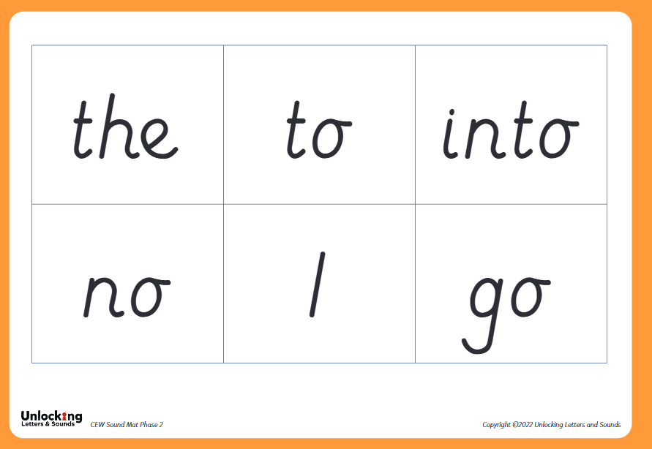
Phase 2 CEWs

Slide 7
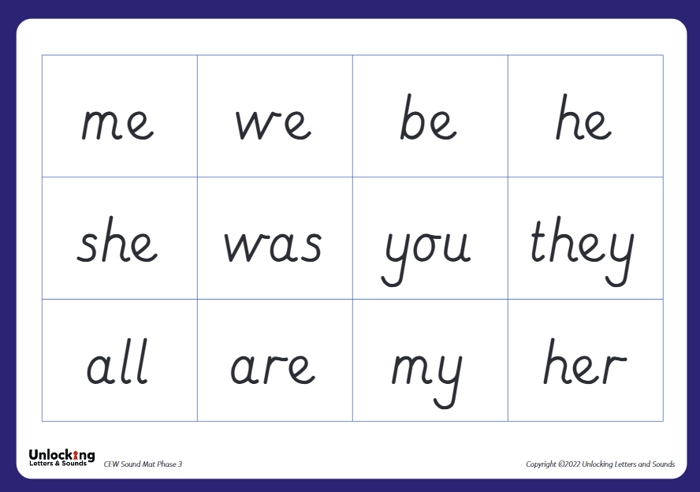
Phase 3 CEWs

Slide 8
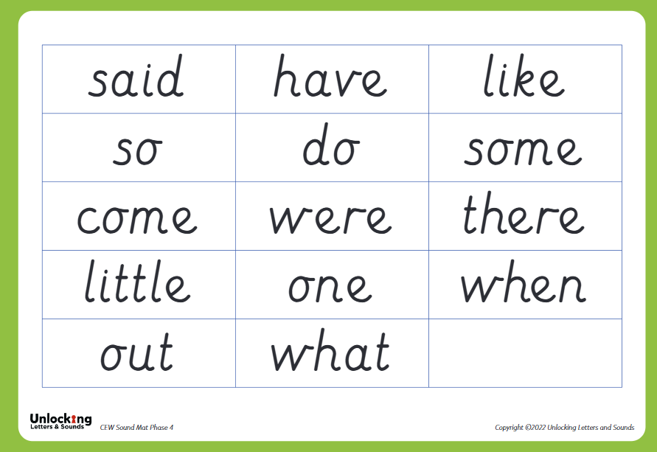
Phase 4 CEWs

